Slide 1
Stochastic Generative Modelling
A general probabilistic framework for many forms of machine learning

Slide 2
Three stages
Modeling
Training
Inference

Slide 3
Modeling
Define a possible class Φ of probabilistic models that you will choose from. We will assume (often unrealistically) that the data is being generated by some process Q in Φ and that the data items are independent executions of Q.
Sometimes the models in Φ are all structurally the same and vary only in numerical parameters; sometimes they include variations in structure as well.
In principle modeling is done before looking at the data, just on the basis of problem characteristics. In practice, that’s often not the case.

Slide 4
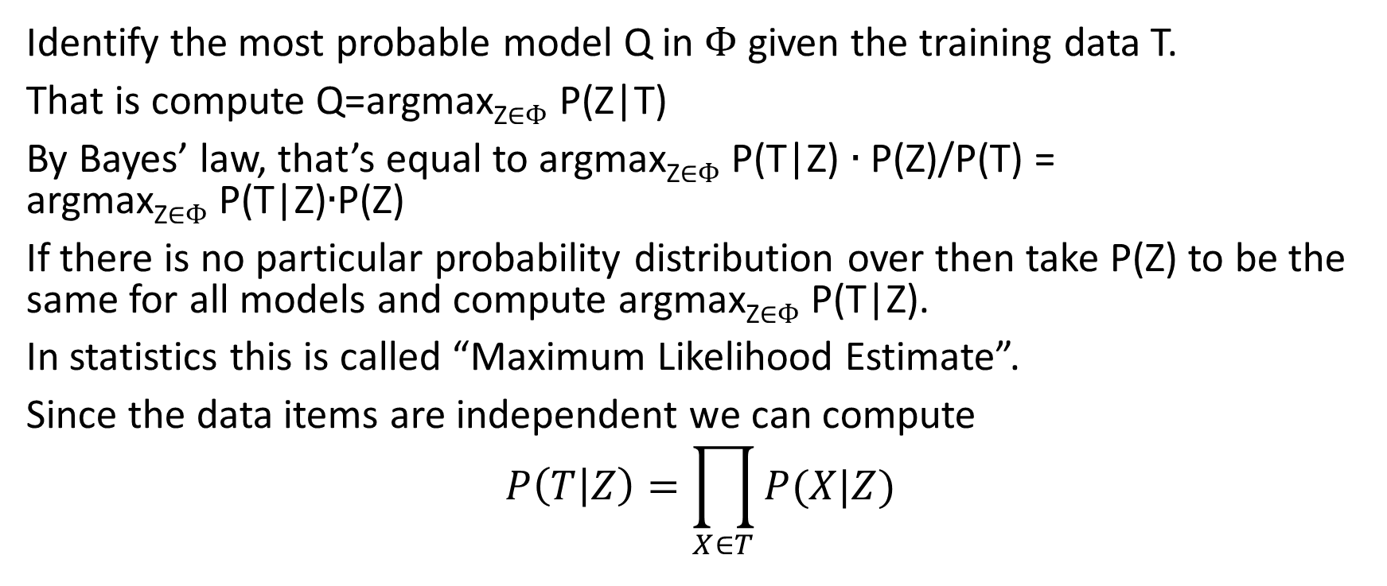
Training
Identify the most probable model Q in Φ given the training data T.
That is compute Q=argmax_{Z∈Φ} P(Z|T)
By Bayes’ law, that’s equal to argmax_{Z∈Φ} P(T|Z) ∙ P(Z)/P(T) = argmax_{Z∈Φ} P(T|Z)∙P(Z)
If there is no particular probability distribution over then take P(Z) to be the same for all models and compute argmax_{Z∈Φ} P(T|Z).
In statistics this is called “Maximum Likelihood Estimate”.
Since the data items are independent we can compute
$$P\left(T | Z\right)=\prod_{X∈T}{P(X|Z)}$$

Slide 5

Training
Since the data items are independent we can compute
$$P\left(T | Z\right)=\prod_{X∈T}{P(X|Z)}$$
Or we can take the log:
$$log⁡(P\left(T | Z\right))=\sum_{X∈T}{log⁡(P\left(X | Z\right))}$$

Slide 6
Inference
Having chosen a model Q, one uses it to solve the inference problems.
That is, given a problem X and a class of answers Δ, choose the answer A ∈Δ that is most likely to be generated together with X by Q.
A = argmax_{D∈Δ} P(D|X,Q)
For classification learning, this is the most probable value of the classification attribute given the prediction attributes.

Slide 7
Discrete Naïve Bayes
To simplify: The classification attribute C has three values {r,w,b}
There are two predictive attributes, A₁ and A₂.
The stochastic process has two levels.
Top level: Spin a roulette wheel to choose the value of C.
Lower level. For each value of C, there are two roulette wheels: One to choose A₁ the other to choose A₂

Slide 8
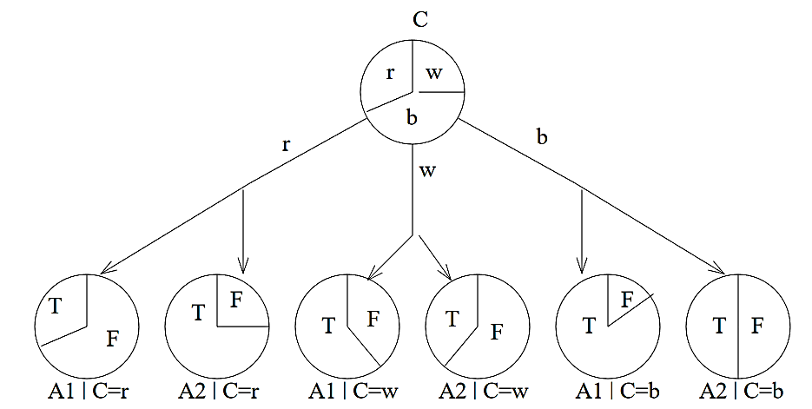

Slide 9
SGM for Naïve Bayes
Space of models: All the models in Ω have this structure. They differ in the probabilities on each of the roulette wheels.
p_{c} = the probability that the top wheel comes up “c”.
p_{c,a,x} = the probability that the roulette wheel for attribute a in the collection for classification attribute c comes up x.
Training: Find the assignment of probabilities that maximizes the probability of the training data. That’s the model Q.
Inference: Having chosen the model, given the values of the attributes (the outputs of the lower level wheels), determine which value of the classification attribute maximizes the overall probability.

Slide 10
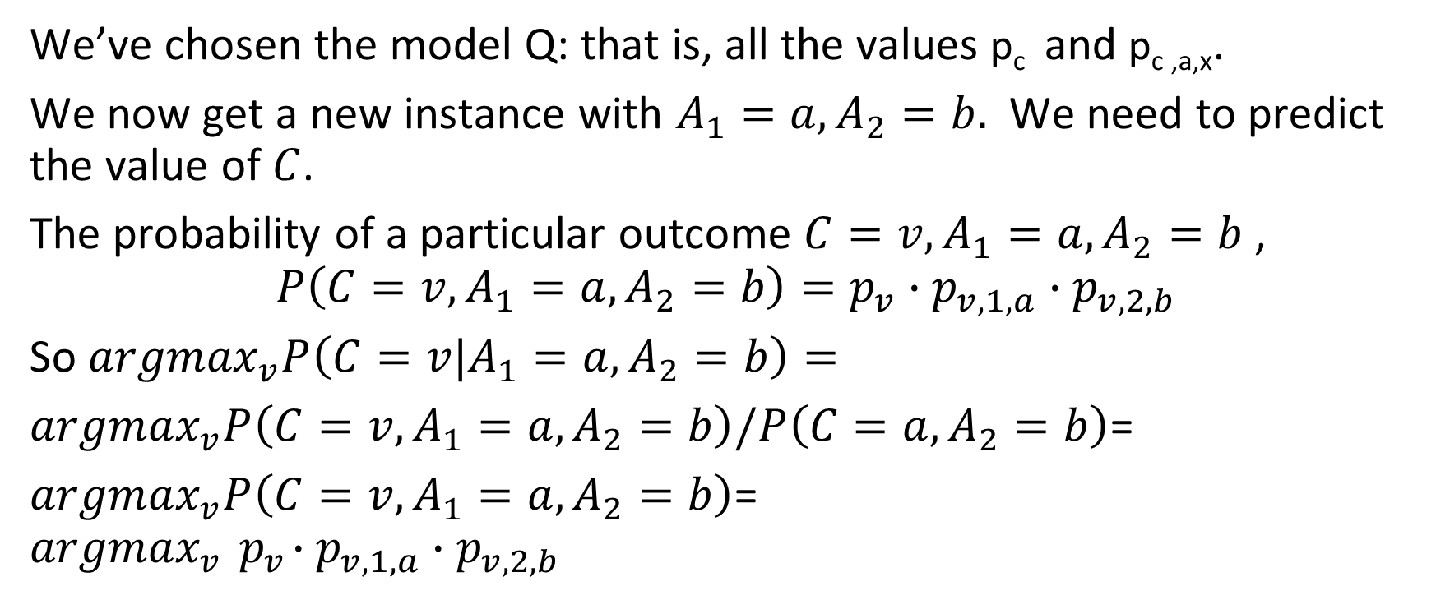
Inference
We’ve chosen the model Q: that is, all the values p_{c} and p_{c ,a,x}.
We now get a new instance with $A_{1}=a,A_{2}=b.$ We need to predict the value of $C$.
The probability of a particular outcome ${C=v,A}_{1}=a,A_{2}=b$,
$$P\left({C=v,A}_{1}=a,A_{2}=b\right)=p_{v}∙p_{v,1,a}∙p_{v,2,b}$$
So ${argmax}_{v}P\left({C=v|A}_{1}=a,A_{2}=b\right)=$
${argmax}_{v}P\left({C=v,A}_{1}=a,A_{2}=b\right)/P\left(C=a,A_{2}=b\right)$=
${argmax}_{v}P\left({C=v,A}_{1}=a,A_{2}=b\right)$=
$${argmax}_{v}{ p}_{v}∙p_{v,1,a}∙p_{v,2,b}$$

Slide 11
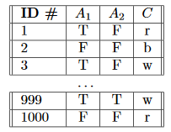

Training
We’re given a training set:
We need to compute the values of $p_{v},p_{v,1,a},p_{v,2,b}$ that will make this specific outcome as likely as possible. Of course, this specific outcome will be at best astronomically unlikely in any case but some values make it astronomically more likely than others.

Slide 12

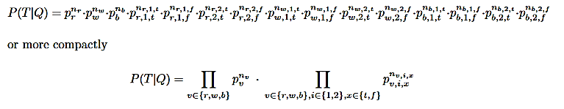

The probability of the training data given the model
The probability of a particular row:
is $p_{w}∙p_{w,1,T}∙p_{w,2,F}$
The probability of the table is the product of the probabilities of the rows:

Slide 13
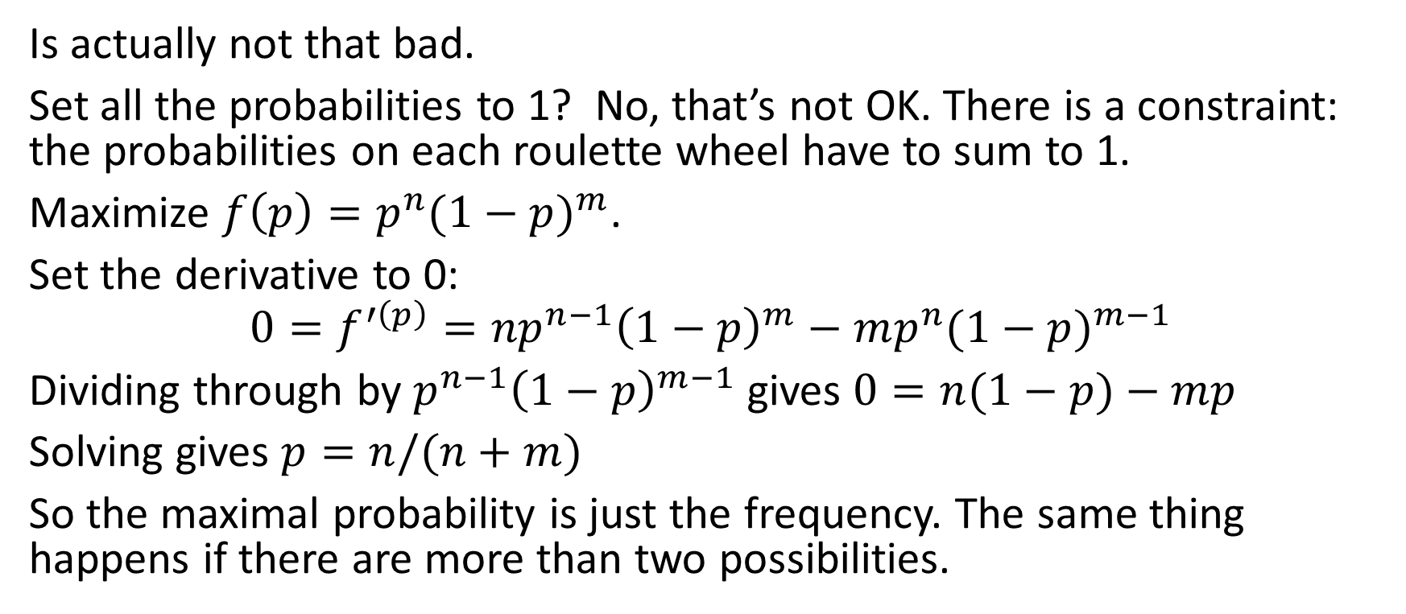
Maximizing that horrible expression
Is actually not that bad.
Set all the probabilities to 1? No, that’s not OK. There is a constraint: the probabilities on each roulette wheel have to sum to 1.
Maximize $f\left(p\right)=p^{n}{(1−p)}^{m}$.
Set the derivative to 0:
$$0=f^{′\left(p\right)}={np}^{n−1}{\left(1−p\right)}^{m}−mp^{n}{(1−p)}^{m−1}$$
Dividing through by $p^{n−1}{\left(1−p\right)}^{m−1}$ gives $0=n(1−p)−mp$
Solving gives $p=n/(n+m)$
So the maximal probability is just the frequency. The same thing happens if there are more than two possibilities.

Slide 14
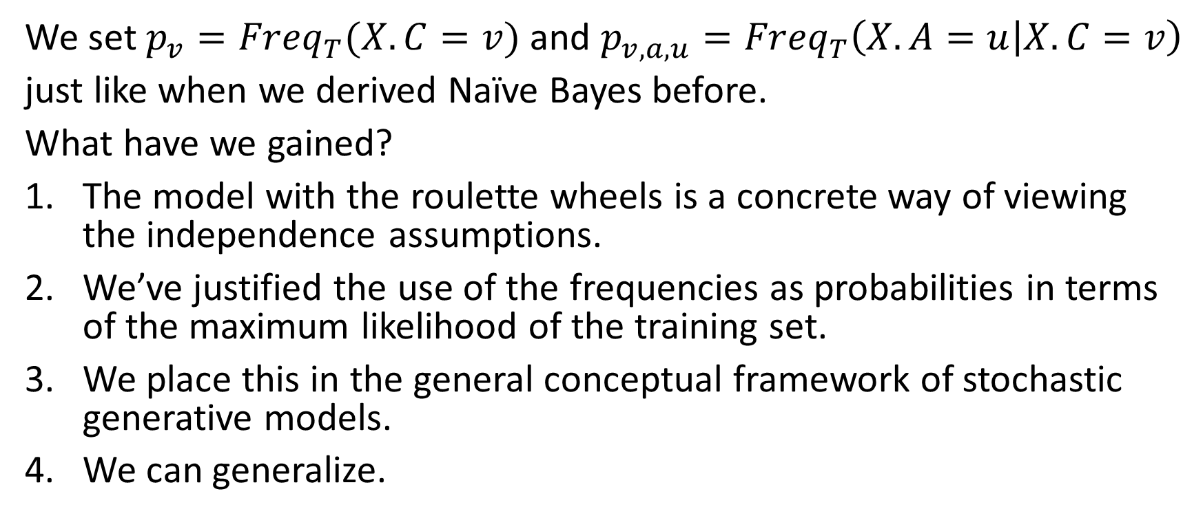
So
We set $p_{v}={Freq}_{T}(X.C=v)$ and $p_{v,a,u}={Freq}_{T}\left(X.A=u | X.C=v\right)$
just like when we derived Naïve Bayes before.
What have we gained?
The model with the roulette wheels is a concrete way of viewing the independence assumptions.
We’ve justified the use of the frequencies as probabilities in terms of the maximum likelihood of the training set.
We place this in the general conceptual framework of stochastic generative models.
We can generalize.

Slide 15
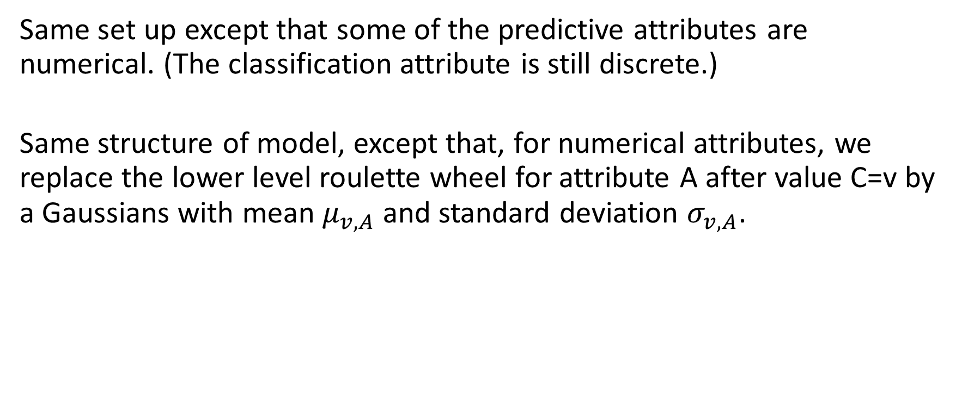
Naïve Bayes where some of the predictive attributes are numerical
Same set up except that some of the predictive attributes are numerical. (The classification attribute is still discrete.)
Same structure of model, except that, for numerical attributes, we replace the lower level roulette wheel for attribute A after value C=v by a Gaussians with mean $μ_{v,A}$ and standard deviation $σ_{v,A}$.

Slide 16
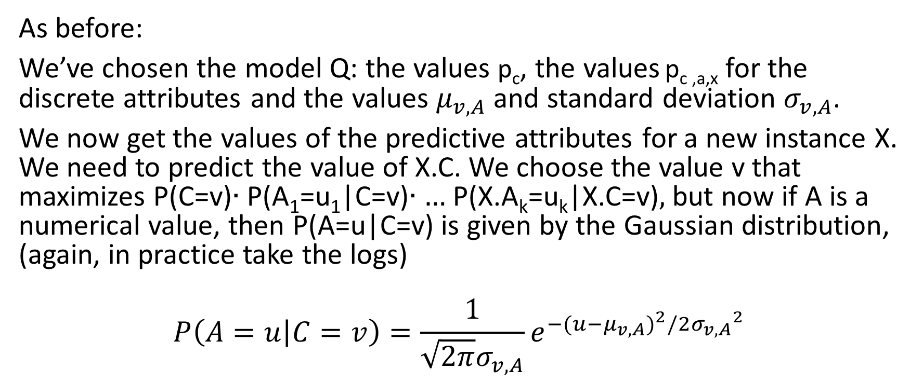
Inference
As before:
We’ve chosen the model Q: the values p_{c}, the values p_{c ,a,x} for the discrete attributes and the values $μ_{v,A}$ and standard deviation $σ_{v,A}$.
We now get the values of the predictive attributes for a new instance X. We need to predict the value of X.C. We choose the value v that maximizes P(C=v)∙ P(A₁=u₁|C=v)∙ … P(X.A_{k}=u_{k}|X.C=v), but now if A is a numerical value, then P(A=u|C=v) is given by the Gaussian distribution, (again, in practice take the logs)
$$P\left(A=u | C=v\right)=\frac{1}{\sqrt{2π}σ_{v,A}}e^{−(u−μ_{v,A})^{2}/2{σ_{v,A}}^{2}}$$

Slide 17
Training
Suppose that you have a sequence of numbers: S=[1.1, 3.2, 7.8].
You believe these are the output of a Gaussian process with mean μ and standard deviation σ.
What values of μ and σ maximizes the probability density of this outcome?

Slide 18
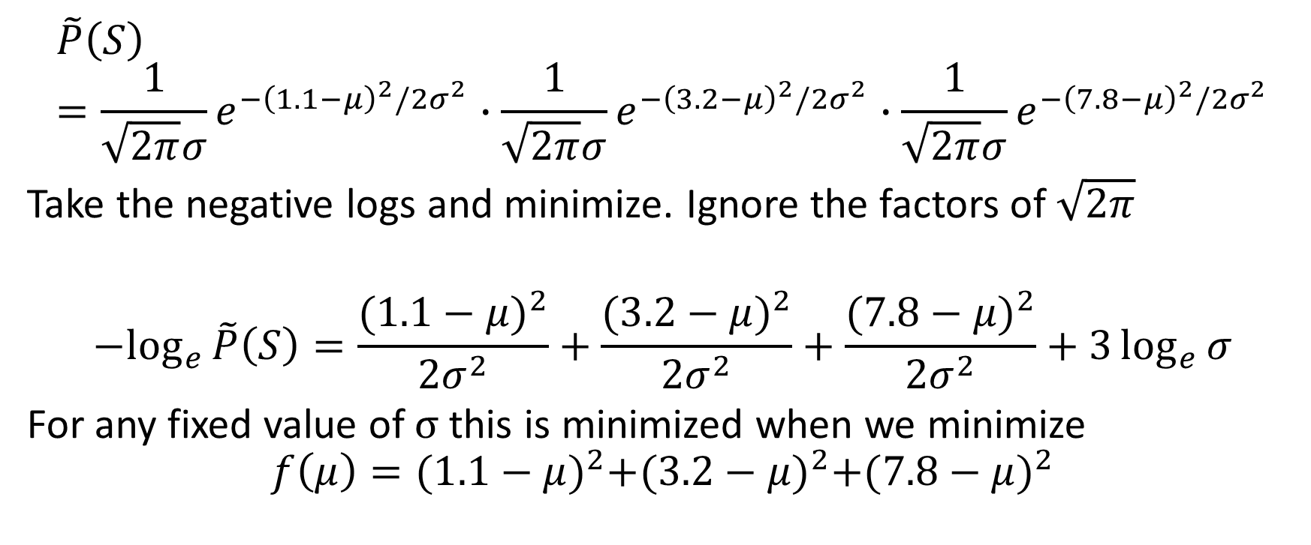
$$\tilde{P}\left(S\right)=\frac{1}{\sqrt{2π}σ}e^{−{\left(1.1−μ\right)}^{2}/2σ^{2}}∙\frac{1}{\sqrt{2π}σ}e^{−{\left(3.2−μ\right)}^{2}/2σ^{2}}∙\frac{1}{\sqrt{2π}σ}e^{−{\left(7.8−μ\right)}^{2}/2σ^{2}}$$
Take the negative logs and minimize. Ignore the factors of $\sqrt{2π}$
$${−log}_{e}{\tilde{P}\left(S\right)=\frac{{(1.1−μ)}^{2}}{2σ^{2}}}+\frac{{(3.2−μ)}^{2}}{2σ^{2}}+\frac{{(7.8−μ)}^{2}}{2σ^{2}}+3\log_{e}{σ}$$
For any fixed value of σ this is minimized when we minimize
$$f\left(μ\right)={(1.1−μ)}^{2}+{(3.2−μ)}^{2}+{(7.8−μ)}^{2}$$

Slide 19
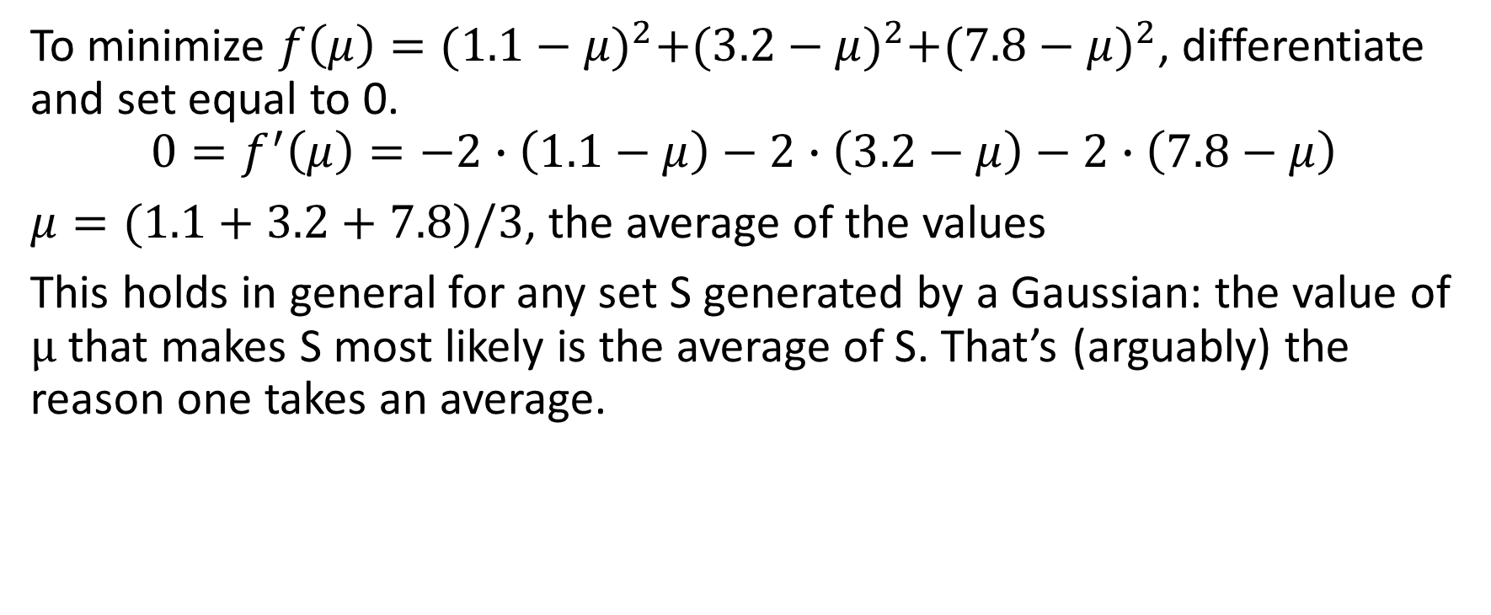
To minimize $f\left(μ\right)={(1.1−μ)}^{2}+{(3.2−μ)}^{2}+{(7.8−μ)}^{2}$, differentiate and set equal to 0.
$${0=f}^{′}\left(μ\right)=−2∙\left(1.1−μ\right)−2∙\left(3.2−μ\right)−2∙\left(7.8−μ\right)$$
$μ=(1.1+3.2+7.8)/3$, the average of the values
This holds in general for any set S generated by a Gaussian: the value of μ that makes S most likely is the average of S. That’s (arguably) the reason one takes an average.

Slide 20
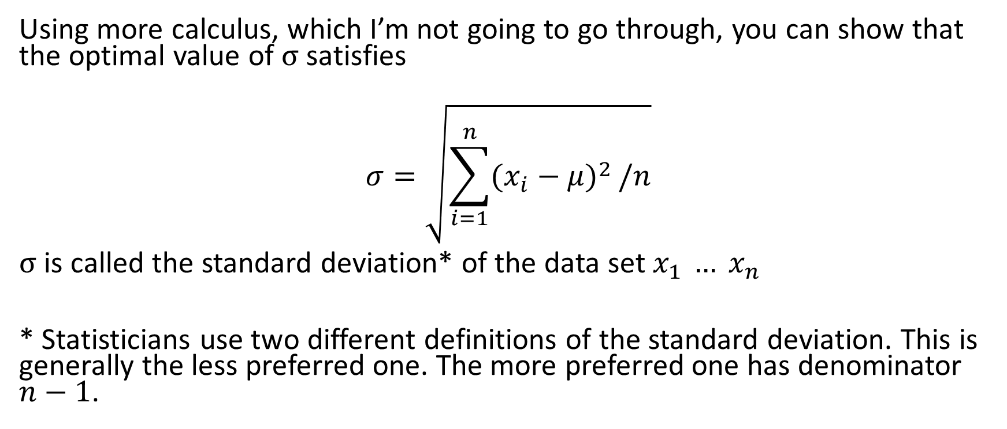
Using more calculus, which I’m not going to go through, you can show that the optimal value of σ satisfies
$$σ=\sqrt{\sum_{i=1}^{n}{{(x_{i}−μ)}^{2}}/n}$$
σ is called the standard deviation* of the data set $x_{1 }… x_{n}$
* Statisticians use two different definitions of the standard deviation. This is generally the less preferred one. The more preferred one has denominator $n−1$.

Slide 21
Back to Naïve Bayes with numerical parameters
A is a numerical predictive parameter.
v is a value of the classification attribute C.
Let S be the set of all values of A in training set instances where C=v.
Set μ to be the average of the values in S and σ to be their standard deviation.

Slide 22
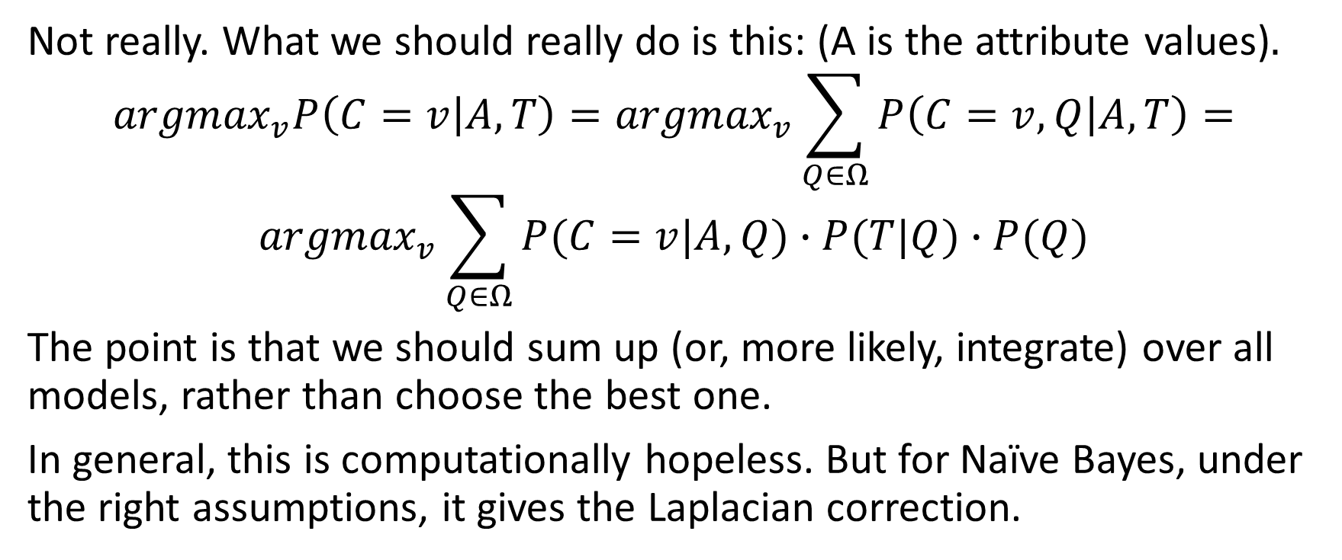
Is this two-step process (get the single best model from training and use it for inference) what probability theory tells us to do?
Not really. What we should really do is this: (A is the attribute values)$.$
$${argmax}_{v}P\left(C=v | A,T\right)={argmax}_{v}\sum_{Q∈Ω}{P\left(C=v,Q | A,T\right)=}$$
$${argmax}_{v}\sum_{Q∈Ω}{P(C=v|A,Q)∙P(T|Q)∙P(Q)}$$
The point is that we should sum up (or, more likely, integrate) over all models, rather than choose the best one.
In general, this is computationally hopeless. But for Naïve Bayes, under the right assumptions, it gives the Laplacian correction.

